Slide 1
Guided Capstone Project Recommendation

Slide 2
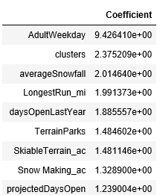
Initial Findings
We have analyzed records from resort across North America to form a correlation between weekend pricing of tickets and other features of any resort under consideration.
We have clustered resort into 3 group to make the relation more accurate based on the clusters which is grouping of resort based on similar traits.
Top factors on which the week end prices depends are –

Slide 3
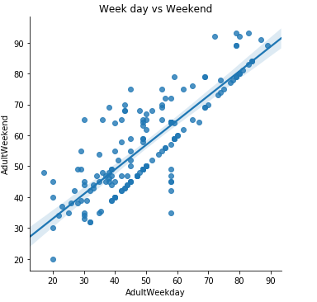
There is high positive relation between weekday pricing and weekends which make sense as people expect pricing of week day and weekend to have this strong relation .
Other factor affecting the pricing is average snowfall . People expect to pay higher price to resort who have been witnessing higher average snowfall.
In my finding a resort should factor in the above discussed features while taking call on increasing revenue by hiking the ticket price

